Slide 1
Chapter 7
CPT Coding

Slide 2
Overview of CPT
CPT coding system:
Descriptive terms and identifying codes for reporting medical services and procedures
Provides uniform language that describes medical, surgical, and diagnostic services
Published by the American Medical Association (AMA)
(continues)

Slide 3
Overview of CPT (continued)
CPT codes:
Five digits in length
Descriptions reflect health care services and procedures performed in modern medical practice.
Reviewed by AMA to update codes and descriptions annually

Slide 4
CPT Codes
Category I CPT codes
Five-digit CPT code and descriptor nomenclature
Organized in six sections
Category II CPT codes
Reported to track performance measurements
Use is optional.
Category III CPT codes
Contains “emerging technology” temporary codes
Assigned for data purposes
Archived after five years unless accepted for placement

Slide 5
CPT Category I Sections
Evaluation and Management (E/M)
Anesthesia
Surgery
Radiology
Pathology and Laboratory
Medicine

Slide 6
CPT Category I Code Number Format
Five-digit code number and narrative
description for each procedure and service
Stand-alone code—includes complete description of procedure or service
Indented code—appears below stand-alone code, requiring coder to refer back to common portion of code description located before semicolon

Slide 7
CPT Category II Codes
Tracking codes used for performance measurement in compliance with PQRS
Assigned for certain services or test results that support performance measures
Alphanumeric and consist of four digits followed by alpha character F
Reporting is optional.
(continues)

Slide 8
CPT Category III Codes (continued)
Allow for utilization tracking of emerging:
Technology
Procedures
Services
Facilitate data collection/assessment about new services/procedures during FDA approval process
Alphanumeric and consist of four digits followed by the alpha character T

Slide 9
CPT Appendices
Appendix A—CPT modifiers/descriptions
Appendix B—Added/deleted/revised codes
Appendix C—E/M clinical examples
Appendix D—Summary list of add-on codes
(continues)

Slide 10
CPT Appendices (continued)
Appendix E—Codes exempt from modifier -51
Appendix F—Codes exempt from modifier -63
Appendix G—Codes that include moderate (conscious) sedation
Appendix H—Clinical topics (www.ama- assn.org)

Slide 11
CPT Appendices (continued)
Appendix I—Removed from coding manual
Appendix J—Electrodiagnostic medicine listing of sensory, motor, and mixed nerves
Appendix K—Products pending FDA approval

Slide 12
CPT Appendices (continued)
Appendix L—List of vascular families
Appendix M—Crosswalk of deleted and renumbered codes
Appendix N—Resequenced codes
Appendix O—Administrative codes for multianalyte assays

Slide 13
CPT Symbols
● | New code
▲ | Revised code description
 | Revised guidelines and notes
; | Used to save space Some descriptions are not printed in entirety next to code. Entry is indented. Coders refer to common portion of code description located before semicolon.
 | Add-on code
 | Exempt from modifier -51
(continues)

Slide 14
CPT Symbols (continued)
◉ | Procedure includes moderate (conscious) sedation. Moderate (conscious) sedation—Administration of moderate sedation or analgesia, which results in drug-induced depression of consciousness
 | FDA approval pending
○ | Indicates a reinstated or recycled CPT code
# | Resequenced codes
➲ | Refer to CPT Assistant or CPT Changes: An Insider’s View for guidance.
➲ | Refer to Clinical Examples in Radiology for guidance.

Slide 15
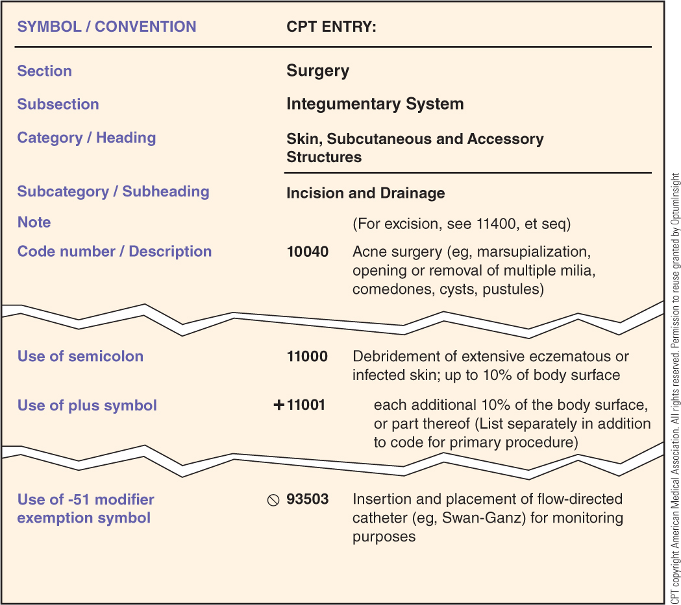
CPT Sections, Subsections, Categories, and Subcategories

Slide 16
Guidelines
Located at beginning of each CPT section
Carefully reviewed before assigning codes
Guidelines—define and explain assignment of codes, procedures, and services in a particular CPT section
(continues)

Slide 17
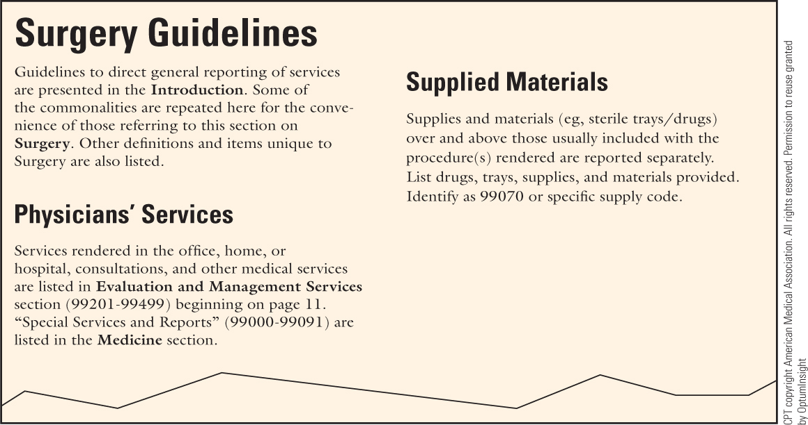
Guidelines (continued)

Slide 18
Unlisted Procedures/Services
Assigned for procedure or service for which there is no CPT code
Special report (e.g., copy of procedure report) is attached to claim to describe:
Nature
Extent
Need for procedure or service
Time, effort, and equipment necessary

Slide 19
Notes
Instructional notes—appear throughout CPT to clarify assignment of codes
Blocked unindented note—located below subsection title and contains instructions that apply to all codes in that subsection
Indented parenthetical note—located below subsection title, code description, or a code description that contains an example
(continues)

Slide 20
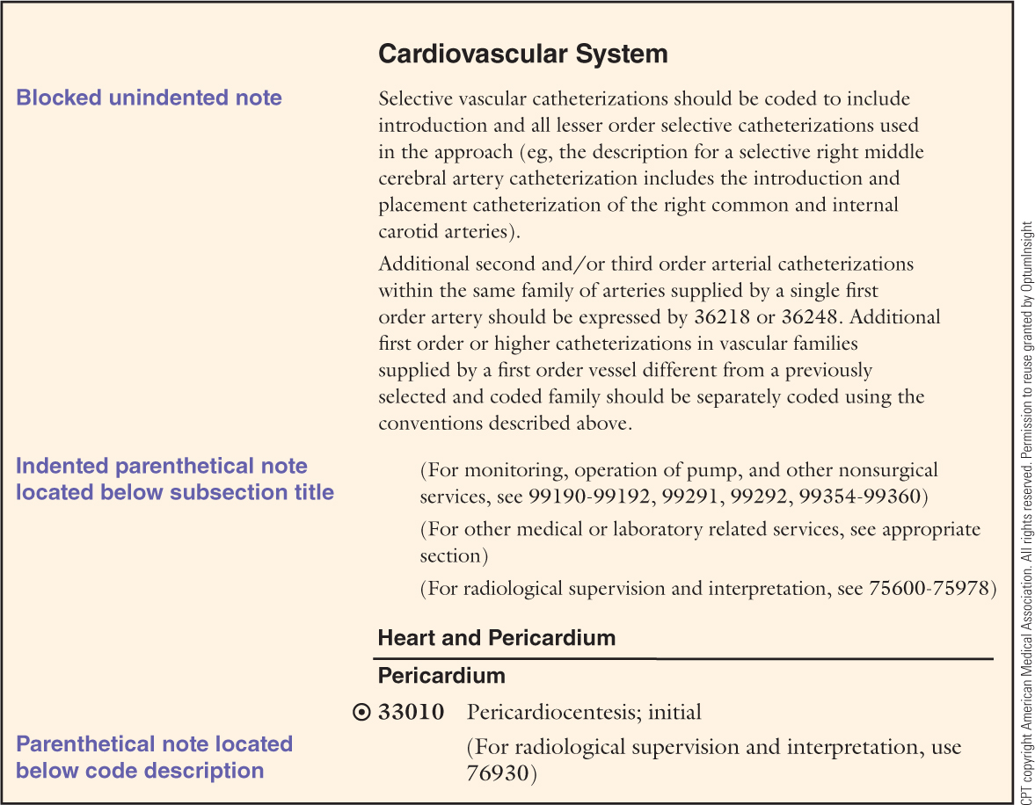
Notes (continued)

Slide 21
Descriptive Qualifiers
Terms that clarify assignment of CPT code
Can occur in middle of main clause or after the semicolon
May or may not be enclosed in parentheses

Slide 22
CPT Index
Organized by alphabetical main terms
Main terms represent:
Procedures or services
Organs or anatomic sites
Conditions
Synonyms, eponyms, and abbreviations

Slide 23
CPT Index—Modifying Terms
Main term may be followed by subterms that modify main term and/or terms they follow.
Subterms may also be followed by additional subterms that are indented.

Slide 24
CPT Index—Single Codes and Code Ranges
Index code numbers are represented by:
Single code number
Range of codes, separated by:
Dash
Series of codes separated by commas
Combination of single codes and ranges of codes
Note: Review all listed codes before assigning a code for the procedure or service.

Slide 25
CPT Index—Conventions
Boldface type
Main terms in the CPT index are printed in boldface type.
Note: CPT categories, subcategories, headings, and code numbers are also printed in boldface type.
Cross-reference term See
Directs coders to index entry under which code is listed
Italicized type is used for cross-reference term See.
(continues)

Slide 26
CPT Index—Conventions (continued)
Inferred words—used to save space when referencing subterms

Slide 27
CPT Modifiers
Clarify services and procedures performed by providers.
CPT code and description remain unchanged.
Modifiers indicate that description of service or procedure performed has been altered.
(continues)

Slide 28
CPT Modifiers (continued)
Reported as two-digit numeric codes added to the five-digit CPT code
HCPCS level II (national) two-character alphanumeric modifiers are added to CPT codes when reporting outpatient services.

Slide 29
CPT Modifiers (continued)
-22 | Increased procedural services
-23 | Unusual anesthesia
-24 | Unrelated evaluation and management service by the same physician or other qualified health care professional during a postoperative period
-25 | Significant, separately identifiable evaluation and management service by the same physician or other qualified health care professional on the same day of the procedure or other service

Slide 30
CPT Modifiers (continued)
-26 | Professional component
-27 | Multiple outpatient hospital E/M encounters on the same date
-32 | Mandated services
-33 | Preventive services
-47 | Anesthesia by surgeon
-50 | Bilateral procedure
-51 | Multiple procedures

Slide 31
CPT Modifiers (continued)
-52 | Reduced services
-53 | Discontinued procedure
-54 | Surgical care only
-55 | Postoperative management only
-56 | Preoperative management only
-57 | Decision for surgery
-58 | Staged or related procedure or service by the same physician or other qualified health care professional during the postoperative period

Slide 32
CPT Modifiers (continued)
-59 | Distinct procedural service
-62 | Two surgeons
-63 | Procedure performed on infants less than 4 kg
-66 | Surgical team
-73 | Discontinued outpatient hospital/ambulatory surgery center (ASC) procedure prior to administration of anesthesia

Slide 33
CPT Modifiers (continued)
-74 | Discontinued outpatient hospital/ambulatory surgery center (ASC) procedure after administration of anesthesia
-76 | Repeat procedure or service by same physician or other qualified health care professional
-77 | Repeat procedure by another physician or other qualified health care professional

Slide 34
CPT Modifiers (continued)
-78 | Unplanned return to the operating/procedure room by the same physician or other qualified health care professional following initial procedure for a related procedure during the postoperative period
-79 | Unrelated procedure or service by the same physician or other qualified health care professional during the postoperative period

Slide 35
CPT Modifiers (continued)
-80 | Assistant surgeon
-81 | Minimum assistant surgeon
-82 | Assistant surgeon (when qualified resident surgeon not available)
-90 | Reference (outside) laboratory
-91 | Repeat clinical diagnostic laboratory test
-92 | Alternative laboratory platform testing
-99 | Multiple modifiers

Slide 36
CPT Modifiers—CMS-1500 Claim, Block 24D

Slide 37
Coding Procedures and Services
Step 1—Read introduction in CPT manual.
Step 2—Review guidelines at beginning of each section.
Step 3—Review procedure or service listed in the source document (e.g., patient record).
Code what is documented in source document.
Obtain clarification from provider if necessary.
(continues)

Slide 38
Coding Procedures and Services (continued)
Step 4—Refer to CPT index, and locate main term for procedure or service documented.
Main terms can be located by referring to:
Procedure or service documented
Organ or anatomic site
Condition documented in the record
Substance being tested
Synonym
Eponym
Abbreviation

Slide 39
Coding Procedures and Services (continued)
Step 5—Locate subterms, and follow cross-references.
Step 6—Review descriptions of codes, and compare qualifiers to descriptive statements.
Step 7—Assign code number, applicable add-on or additional codes, and/or modifiers.

Slide 40
Evaluation and Management Section
Located at beginning of CPT because these codes describe services most frequently provided by physicians
Accurate assignment is essential to success of physician practice because most revenue is generated by these services.

Slide 41
E/M Level of Service
Reflects amount of work involved in providing care to patient:
Extent of history performed
Extent of examination performed
Complexity of medical decision making
Three to five levels of service are included in E/M categories.
Documentation in chart must support level of service.

Slide 42
Accurate Assignment of E/M Codes
Identify place of service (POS).
Identify type of service (TOS).
Determine whether patient is new or established.
Review documentation for level of service components.
Apply CMS’s Documentation Guidelines for Evaluation and Management Services.

Slide 43
Evaluation and Management Terms
Place of service—physical location where care is provided (e.g., physician office)
Type of service—kind of health care services provided to patients (e.g., critical care)
(continues)

Slide 44
Evaluation and Management Terms (continued)
New patient—one who has not received any professional services from physician, or from another physician of same specialty who belongs to same group practice, within past three years
Established patient—one who has received professional services from physician, or from another physician of same specialty who belongs to same group practice, within past three years

Slide 45
Evaluation and Management Terms (continued)
Concurrent care—provision of similar services to same patient by more than one provider on same day
Transfer of care—physician who is managing some or all of patient’s problems releases patient to another provider’s care

Slide 46
Level of E/M Services
Categories/subcategories contain codes according to level of services for reporting to payers.
Example: Code 99213 is level 3 E/M service.
Last number of some E/M codes represents level of service, but levels within categories and subcategories are not interchangeable.
(continues)

Slide 47
Level of E/M Services (continued)
Include conferences with or about patients, evaluations, examinations, and so on.
Typically, just one E/M code is reported each day by a provider for a patient.
When separately identifiable E/M service is provided in addition to surgical procedure, add modifier -25 to E/M code.

Slide 48
Level of E/M Services (continued)
Include seven components, six of which determine level of E/M service code:
History
Examination
Medical decision making
Counseling
Coordination of care
Nature of presenting problem
Time

Slide 49
E/M Key Components
Key components—history, examination, and medical decision making
Contributory components—counseling, coordination of care, nature of presenting problem, and time
Must be focus of visit to be used in selection of E/M code

Slide 50
Extent of History
History—interview of patient that includes HPI and CC, ROS, and PFSH
Extent of history—categorized according to four levels:
Problem-focused history
Expanded problem-focused history
Detailed history
Comprehensive history

Slide 51
Extent of Examination
Physical examination—assessment of patient’s body areas and organ systems
Extent of examination—categorized according to four levels:
Problem-focused examination
Expanded problem-focused examination
Detailed examination
Comprehensive examination

Slide 52
Complexity of Medical Decision Making
Complexity of establishing diagnosis and/or selecting management option
Measured by:
Number of diagnoses or management options
Amount and/or complexity of data to be reviewed
Risk of complications and/or morbidity or mortality
(continues)

Slide 53
Complexity of Medical Decision Making (continued)
Types of medical decision making:
Straightforward
Low complexity
Moderate complexity
High complexity

Slide 54
Contributory Components
Counseling—discussion with patient and/or family concerning one or more of the following areas:
Diagnostic results
Impressions
Recommended diagnostic studies
Prognosis
Risks and benefits of management options
Instructions for management/follow-up
Importance of compliance with chosen management options
Risk factor reduction
Patient and family education
(continues)

Slide 55
Contributory Components (continued)
Coordination of care—when physician makes arrangements with other providers or agencies for patient services
Nature of the presenting problem—disease, condition, illness, injury, symptom, sign, finding, complaint, or other reason for encounter, with or without diagnosis established at time of encounter

Slide 56
Contributory Components (continued)
Five types of presenting problems:
Minimal
Self-limited or minor
Low severity
Moderate severity
High severity
Face-to-face time—amount of time provider spends with patient and/or family

Slide 57
Contributory Components (continued)
Unit/floor time—amount of time provider spends at patient’s bedside and managing patient’s care on unit or floor; applies to:
Inpatient hospital care
Hospital observation care
Initial and follow-up inpatient hospital consultations
Nursing facility services

Slide 58
E/M Subsections
Office or other outpatient services
Hospital observation services
Furnished in hospital outpatient setting
Patient is considered outpatient.
Hospital inpatient services
Initial hospital care
Subsequent hospital care
Observation or inpatient care services
Hospital discharge services
(continues)

Slide 59
E/M Subsections (continued)
Consultations
Examination of patient by health care provider, usually a specialist, for purpose of advising referring or attending physician in E/M of specific problem
Consultants may initiate diagnostic and/or therapeutic services as necessary during consultation.
Referral—when patient reports that another provider “referred” patient to provider; not a consultation (continues)

Slide 60
E/M Subsections (continued)
Consultations (continued)
Preoperative clearance—when surgeon requests specialist or other physician to examine patient and provide opinion about whether patient can withstand expected risks of specific surgery
When referring surgeon documents written request for preoperative clearance, service is considered a consultation.

Slide 61
E/M Subsections (continued)
Emergency department services
Provided in a hospital that is open 24 hours for the purpose of providing unscheduled episodic services to patients who require immediate medical attention
Critical care services
Reported when physician directly delivers medical care to critically ill or critically injured patient

Slide 62
E/M Subsections (continued)
Nursing facility services
Provided at a(n) NF, SNF, ICF, LTCF, or psychiatric residential treatment facility
Domiciliary, rest home (e.g., boarding home), or custodial care services

Slide 63
E/M Subsections (continued)
Domiciliary, rest home (e.g., assisted living facility), or home care plan oversight services
Cover physician’s time supervising complex and multidisciplinary care treatment programs
Home services
Provided to individuals in their place of residence
Promote, maintain, or restore health
Minimize effects of disability and illness

Slide 64
E/M Subsections (continued)
Prolonged services
Patient contact that is considered beyond the usual service in either an inpatient or outpatient setting
Direct patient contact—face-to-face patient contact
Without direct patient contact—non-face-to-face time occurring before and/or after patient care

Slide 65
E/M Subsections (continued)
Case management services
Processes in which a physician is responsible for:
Direct care of patient
Coordinating and controlling access to or initiating health care services
Supervising other health care services needed by patient

Slide 66
E/M Subsections (continued)
Care plan oversight services
Cover physician’s time spent supervising complex and multidisciplinary care treatment program for a specific patient who is under the care of a:
Home health agency
Hospice
Nursing facility

Slide 67
E/M Subsections (continued)
Preventive medicine services
Routine examinations
Risk management counseling
Also called wellness visits
Non-face-to-face physician services
Telephone services
Online medical evaluation

Slide 68
E/M Subsections (continued)
Special evaluation and management services
Establishment of baseline information prior to life or disability insurance certificates being issued
Examination of a patient with a work-related or medical disability problem
Newborn care services
Provided to newborns in a variety of settings
Includes delivery/birthing room attendance and resuscitation services

Slide 69
E/M Subsections (continued)
Delivery/birthing room attendance and resuscitation services
Inpatient neonatal intensive care services and pediatric and neonatal critical care services
Provided to critically ill neonates and infants by a physician
Neonate—newborn, up to 28 days old
Infant—very young child, up to one year old

Slide 70
E/M Subsections (continued)
Care management services
Patient-centered management and support services provided to patients who reside at or in:
Home
Domiciliary
Rest home
Assisted living facility

Slide 71
E/M Subsections (continued)
Transitional Care Management Service
Provided to established patients whose medical and/or psychosocial problems require one of the following during transitions in care from one setting to the patient’s community setting:
Moderate-complexity medical decision making
High-complexity medical decision making

Slide 72
E/M Subsections (continued)
Advance care planning
Other Evaluation and Management Services
Assigned when E/M service provided is not described in any other listed E/M codes
Use of modifiers with this code is not appropriate.
Special report must be submitted with CMS-1500 claim.

Slide 73
Anesthesia Section
Associated with administration of analgesia and/or anesthesia provided by anesthesiologist or CRNA
Includes administration of:
Local, regional, epidural, general anesthesia, and MAC
Anxiolytics or amnesia-inducing medications

Slide 74
Assigning Anesthesia Codes
Anesthesia codes describe general anatomic area or service associated with surgical procedures.
There is no one-to-one correspondence for Anesthesia to Surgery section codes.
The same Anesthesia section code is often reported for different surgical procedures that share similar anesthesia requirements.

Slide 75
Qualifying Circumstances for Anesthesia
Anesthesia services provided during situations or circumstances that make anesthesia administration more difficult, as follows:
99100 (Anesthesia for patient of extreme age, younger than one year and older than 70)
99116 (Anesthesia complicated by utilization of total body hypothermia)
99135 (Anesthesia complicated by utilization of controlled hypotension)
99140 (Anesthesia complicated by emergency conditions)

Slide 76
Physical Status Modifiers
Indicate patient’s condition at time of anesthesia, as follows:
-P1 | normal healthy patient
-P2 | patient with mild systemic disease
-P3 | patient with moderate systemic disease
-P4 | patient with severe systemic disease that is constant threat to life
-P5 | moribund patient who is not expected to survive without operation
-P6 | declared brain-dead patient whose organs are being removed for donor purposes

Slide 77
HCPCS Level II Anesthesia Modifiers
-AA | anesthesia services performed personally by anesthesiologist
-AD | medically supervised by a physician for more than four concurrent procedures
-G8 | monitored anesthesia care (MAC) for deep complex, complicated, or markedly invasive surgical procedure
-G9 | MAC for patient who has a history of severe cardiopulmonary condition
(continues)

Slide 78
HCPCS Level II Anesthesia Modifiers (continued)
-QK | medical direction of two, three, or four concurrent anesthetic procedures involving qualified individuals
-QS | monitored anesthesia care service
-QX | CRNA service, with medical direction by physician
-QY | medical direction of one CRNA by an anesthesiologist
-QZ | CRNA service, without medical direction by physician

Slide 79
CPT Modifiers for Anesthesia Services
-23 | unusual anesthesia
-53 | discontinued procedure
-59 | distinct procedural service
-74 | discontinued outpatient hospital/ambulatory surgery center procedure after anesthesia administration
-99 | multiple modifiers

Slide 80
Anesthesia Time Reporting
Report anesthesia time units in Block 24G of CMS-1500 claim.
Anesthesia time units
Based on total anesthesia time
Reported as one unit for each 15 minutes (or fraction thereof) of anesthesia time
Example: 45 minutes of anesthesia time equals three anesthesia time units. The number 3 is entered in Block 24G of the CMS-1500 claim.

Slide 81
Surgery Section
Organized by body system
Subsections are subdivided into categories by specific organ or anatomic site.
To code surgeries properly, ask the following questions:
What body system was involved?
What anatomic site was involved?
What type of procedure was performed?

Slide 82
Surgical Package
Also called global surgery
Global period—number of days associated with surgical package; designated as 0, 10, or 90 days

Slide 83
Unbundling
Not allowed
Defined as assigning multiple codes to procedures/services when just one comprehensive code should be reported

Slide 84
Separate Procedure
Parenthetical note following code description
Identifies procedures that are an integral part of another procedure or service
Reported if procedure or service is:
Performed independently of comprehensive procedure or service
Unrelated to or distinct from another procedure or service performed at the same time

Slide 85
Multiple Surgical Procedures
When two or more surgeries are performed during the same operative session:
Major surgical procedure code is reported first on CMS-1500 claim.
Lesser surgical procedure codes are reported on CMS-1500 claim, in descending order of expense.
Modifier -51 is added to lesser surgical procedure codes, if symbols  or  are not located in front of the codes.

Slide 86
Radiology Section
Includes subsections for:
Diagnostic radiology (imaging)
Diagnostic ultrasound
Radiation oncology
Nuclear medicine
Subsections are subdivided into anatomic categories.
(continues)

Slide 87
Radiology Section (continued)
Radiologic views—studies taken from different angles
Number of views determines code selection for many radiology procedures.
Review radiology report or charge slip and code descriptions to select appropriate code.
Complete—reference to number of views required for full study of designated body part

Slide 88
Radiology Section (continued)
Radiologic views—studies taken from different angles
Number of views determines code selection for many radiology procedures.
Review radiology report or charge slip and code descriptions to select appropriate code.
Use of Complete in code description
Reference to number of views required for full study of designated body part

Slide 89
Diagnostic Radiology Subsection
Noninvasive and invasive
Includes CT, MRI, and MRA
Accurately code diagnostic radiology procedures by determining:
Anatomic site
Type of procedure
Number of views
Laterality of procedure
Use of contrast media

Slide 90
Diagnostic Ultrasound Subsection
Use of high-frequency sound waves to produce image
Performed:
As followup for inconclusive diagnostic radiology procedures
Intraoperatively
Guidance (e.g., biopsy, cyst localization, invasive procedures, and so on)

Slide 91
Radiologic Guidance Subsection
Performed during a procedure to visualize access to anatomic site
Contains four headings
Fluoroscopic guidance
Computed tomography guidance
Magnetic resonance guidance
Other radiologic guidance

Slide 92
Bone/Joint Studies Subsection
Subsection of CPT Radiology Section, which classifies bone and joint studies only
Example: Female patient, age 51, underwent complete osseous survey. Report code 77075.

Slide 93
Radiation Oncology Subsection
Use of high-energy ionizing radiation to treat:
Malignant neoplasms
Certain nonmalignant conditions
Therapeutic modalities directed at malignant/benign lesions include:
Brachytherapy
Hyperthermia
Stereotactic radiation
Teletherapy

Slide 94
Nuclear Medicine Subsection
Use of radioactive elements for
Diagnostic imaging
Radiopharmaceutical therapy
Isotope emits gamma rays, allowing radiologist to visualize internal abnormalities.
NOTE: Report appropriate HCPCS level II code for radiopharmaceutical administered.

Slide 95
Complete Procedure
When complete is found in code description, one code is reported to “completely” describe procedure performed.
When complete is found in parenthetical note below code, it may be necessary to report more than one code to “completely” describe the procedure performed.

Slide 96
Professional vs. Technical Component
Professional component—covers supervision of procedure and interpretation/ documentation of report describing examination and findings
Technical component—covers use of equipment, supplies provided, and employment of radiologic technicians
(continues)

Slide 97
Professional vs. Technical Component (continued)
When examination occurs in clinic or private office that owns equipment, and professional services are performed by physician employed by clinic or private office, both professional and technical components are billed on the same claim.

Slide 98
Professional vs. Technical Component (continued)
When equipment and supplies are owned by a hospital or other corporation, and radiologist performs only professional component of examination, two separate billings are generated:
One by physician for professional component
One by hospital for technical component

Slide 99
Professional vs. Technical Component (continued)
When two separate billings are required:
CPT modifier -26 (professional component) is added to CPT Radiology code number by physician.
HCPCS level II modifier -TC (technical component) is added to CPT Radiology code by hospital.
Exception to this rule:
When code description restricts use of code to “supervision and interpretation”

Slide 100
Pathology and Laboratory Section
Organized according to type of pathology or laboratory procedure performed
Within each subsection, procedures are listed alphabetically.

Slide 101
Organ- or Disease-Oriented Panels Subsection
Single code numbers assigned to organ- or disease-oriented panels
Consist of blood chemistry studies routinely ordered by providers at the same time for the purpose of investigating a specific organ or disorder
Composition of panel is very specific, and no substitutions are allowed.

Slide 102
Drug Assay Subsection
Laboratory tests that determine whether a drug or a specific classification of drugs is present in:
Blood
Urine

Slide 103
Therapeutic Drug Assays Subsection
Laboratory tests performed to determine how much of a specific prescribed drug is in blood

Slide 104
Evocative/Suppression Testing Subsection
Laboratory tests when substances are injected for purpose of confirming or ruling out specific disorders

Slide 105
Consultations (Clinical Pathology) Subsection
Codes reported by pathologists who perform clinical pathology consultations requested by attending physicians when test result requires additional medical interpretive judgment for:
Face-to-face patient contact
Consultative review of tissue specimen slides
Pathologic consultation during surgery

Slide 106
Urinalysis, Molecular Pathology, Multianalyte Assays with Algorithmic Analyses, Chemistry, Hematology and Coagulation, and Immunology Subsections
Laboratory tests performed on body fluids (e.g., blood and urine)
Tests ordered by physicians and performed by technologists under supervision of a physician (usually a pathologist)

Slide 107
Transfusion Medicine Subsection
Reported for products (e.g., fresh frozen plasma) associated with blood transfusions
NOTE: Codes for transfusion procedure are located in CPT Surgery section (36430–36460), except for leukocyte transfusion (86950).

Slide 108
Microbiology Subsection
Reported for the following procedures:
Bacteriology
Mycology
Parasitology
Virology

Slide 109
Anatomic Pathology Subsection
Reported for postmortem examination, which is also called:
Autopsy
Necropsy

Slide 110
Cytopathology and Cytogenetic Studies Subsection
Reported for:
Pathology screening tests (cytopathology)
Tissue cultures and chromosome analysis studies (cytogenetic studies

Slide 111
Surgical Pathology Subsection
Reported when specimen(s) removed during surgery require pathologic diagnosis
Organized according to level
Refer to codes 88300–88309 for descriptions of levels and associated procedures.

Slide 112
In Vivo Laboratory Procedures Subsection
Reported for noninvasive laboratory procedures that are performed transcutaneously
Measurement is obtained by:
Pressing laboratory instrument against patient’s skin
Using visible and near-infrared optical bands to obtain laboratory value

Slide 113
Other Procedures Subsection
Reported for miscellaneous laboratory procedures, not elsewhere classified in the CPT Pathology and Laboratory section

Slide 114
Reproductive Medicine Procedures Subsection
Reported for:
Oocyte or embryo procedures (coded for the female partner)
Procedures involving sperm alone (coded for the male partner)
Address coding needs in evolving reproductive medicine area

Slide 115
Medicine Section
Classifies noninvasive or minimally invasive diagnostic and therapeutic procedures and services
Noninvasive procedures require no surgical incision or excision, and they are not open procedures.
Minimally invasive procedures include percutaneous access.
(continues)

Slide 116
Medicine Section (continued)
Includes subsections that:
Classify procedures and procedure-oriented services
Apply to various medical specialties
Apply to different types of health care providers

Slide 117
Immune Globulins, Serum or Recombinant Products Subsection
Reported for supply of the immune globulin product, including broad-spectrum and anti-infective immune globulins, antitoxins, and other isoantibodies
Administration of immune globulin is reported separately with code from the Therapeutic, Prophylactic, and Diagnostic Injections and Infusions subsection.

Slide 118
Immunization Administration for Vaccines/Toxoids Subsection
Reported for:
Intradermal injections
Intramuscular injections
Percutaneous injections
Subcutaneous injections
Intranasal and/or oral administration

Slide 119
Vaccines, Toxoids Subsection
Reported to identify vaccine and/or toxoid product only
Reported in addition to immunization administration for vaccine and toxoid codes

Slide 120
Psychiatry Subsection
Reported by psychiatrists, psychologists, and licensed clinical social workers for provision of the following to an individual, family, or group:
Psychiatric diagnostic services
Psychotherapy
Other services

Slide 121
Biofeedback Subsection
Reported for biofeedback services:
Review of the patient’s history
Preparation of biofeedback equipment
Placement of electrodes on patient
Reading and interpreting responses
Monitoring the patient
Control of muscle responses
Biofeedback—technique that trains patients to gain control over autonomic body functions

Slide 122
Dialysis Subsection
Reported for:
Hemodialysis
Miscellaneous dialysis procedures
End-stage renal disease services
Other dialysis procedures

Slide 123
Gastroenterology Subsection
Reported for:
Gastric physiology services
Other procedures

Slide 124
Ophthalmology Subsection
Reported for:
General ophthalmological services
Special ophthalmological services
Contact lens services
Spectacle services (including prosthesis for aphakia)

Slide 125
Special Otorhinolaryngologic Services Subsection
Reported for:
Vestibular function tests without electrical recording
Vestibular function tests with recording
Audiologic function tests
Evaluative and therapeutic services
Special diagnostic procedures
Other procedures
(continues)

Slide 126
Special Otorhinolaryngologic Services Subsection (continued)
When otorhinolaryngologic services are performed during E/M service, do not report component procedure separately (e.g., otoscopy).
However, special otorhinolaryngologic services (92502–92700) not typically included in a comprehensive otorhinolaryngologic evaluation are reported separately.

Slide 127
Cardiovascular Subsection
Reported for:
Therapeutic services and procedures
Cardiography
Cardiovascular monitoring services
Implantable and wearable cardiac device evaluations
Echocardiography
Cardiac catheterization
Intracardiac electrophysiological procedures/studies
Peripheral arterial disease rehabilitation
Noninvasive physiologic studies and procedures
Other vascular studies

Slide 128
Noninvasive Vascular Diagnostic Studies Subsection
Reported for:
Cerebrovascular arterial studies
Extremity arterial and venous studies
Visceral and penile vascular studies
Extremity arterial-venous studies
Noninvasive vascular diagnostic studies
EXAMPLE: Duplex scan, which measures a vessel’s blood flow

Slide 129
Pulmonary Subsection
Reported for:
Ventilator management
Pulmonary diagnostic testing
Pulmonary therapies

Slide 130
Allergy and Clinical Immunology Subsection
Reported for:
Allergy testing
Ingestion challenge testing
Allergen immunotherapy

Slide 131
Endocrinology Subsection
Reported for:
Subcutaneous placement of a sensor for continual glucose (blood sugar) monitoring (up to 72 hours)
Physician interpretation and report of results of monitoring

Slide 132
Neurology and Neuromuscular Procedures Subsection
Reported for services that do not require surgical procedures, including:
Neurology diagnostic and therapeutic services
Neuromuscular diagnostic and therapeutic services that do not require surgical procedures
EXAMPLES: sleep testing, EEG, EMG, motion analysis

Slide 133
Medical Genetics and Genetic Counseling Services Subsection
Reported for counseling of an individual, couple, or family to:
Investigate family genetic history
Assess risks associated with genetic defects in offspring

Slide 134
Central Nervous System Assessments/Tests Subsection
Reported for tests performed to measure cognitive function of central nervous system, including:
Cognitive processes
Visual motor responses
Abstractive abilities

Slide 135
Health and Behavior Assessment/ Intervention Subsection
Reported for tests that identify elements involved in prevention, treatment, and management of physical health problems:
Psychological
Behavioral
Emotional
Cognitive
Social

Slide 136
Hydration, Therapeutic, Prophylactic, Diagnostic Injections and Infusions, and Chemotherapy and Other Highly Complex Drug or Highly Complex Biologic Agent Administration Subsection
Reported for hydration IV infusion that consists of prepackaged fluid and electrolytes (but no drugs or other substances), including:
Administration of local anesthesia
Intravenous (IV) insertion
Access to catheter, IV, or port
Routine syringe, tubing, and other supplies
Flushing performed upon completion of infusion
(continues)

Slide 137
Hydration, Therapeutic, Prophylactic, Diagnostic Injections and Infusions, and Chemotherapy and Other Highly Complex Drug or Highly Complex Biologic Agent Administration Subsection (continued)
Reported for administration of chemotherapeutic agents by multiple routes
Can be reported with E/M service on same day as chemotherapy administration

Slide 138
Hydration, Therapeutic, Prophylactic, Diagnostic Injections and Infusions, and Chemotherapy and Other Highly Complex Drug or Highly Complex Biologic Agent Administration Subsection (continued)
Chemotherapy—drugs that destroy cancer cells, slow growth of cancer cells, keep cancer from spreading to other parts of body, and prevent recurrence of cancer
Adjuvant chemotherapy—chemotherapy administered in addition to other cancer treatments (e.g., surgery and radiation therapy)

Slide 139
Photodynamic Therapy Subsection
Reported for the administration of light therapy to:
Destroy premalignant or malignant lesions
Ablate abnormal tissue using photosensitive drugs

Slide 140
Special Dermatological Procedures Subsection
Reported for dermatology procedures that are typically performed in addition to an appropriate E/M service code

Slide 141
Physical Medicine and Rehabilitation Subsection
Reported for services that focus on the prevention, diagnosis, and treatment of disorders of the following systems, which may produce temporary or permanent impairment:
Musculoskeletal
Cardiovascular
Pulmonary

Slide 142
Medical Nutrition Therapy Subsection
Reported for medical nutrition therapy, which is classified according to:
Type of assessment
Individual or group therapy
Length of time

Slide 143
Acupuncture Subsection
Reported for acupuncture treatment, which is classified:
As face-to-face patient contact for 15-minute increments of time
According to whether electrical stimulation was provided

Slide 144
Osteopathic Manipulative Treatment Subsection
Reported for manual treatment applied by a physician to eliminate or alleviate:
Somatic dysfunction
Related disorders

Slide 145
Chiropractic Manipulative Treatment Subsection
Reported for manual treatments that influence:
Joint function
Neurophysiological function

Slide 146
Education and Training for Patient Self-Management Subsection
Reported for education and training services provided for patient self-management by a qualified, nonphysician health care professional using a standard curriculum
Codes are classified according to length of time spent face-to-face with one or more patients.

Slide 147
Non-Face-to-Face Nonphysician Services Subsection
Reported for:
Telephone services provided to
Established patient
Parent
Guardian
Online medical evaluation

Slide 148
Special Services, Procedures, and Reports Subsection
Reported for special services, procedures, and reports
EXAMPLE: conveyance of specimen for transfer from physician’s office to laboratory

Slide 149
Qualifying Circumstances for Anesthesia Subsection
Reported for situations that complicate administration of anesthesia services:
Emergencies
Extreme age
Hypotension
Hypothermia
Add-on codes, which are reported in addition to code from Anesthesia section

Slide 150
Moderate (Conscious) Sedation Subsection
Reported for drug-induced depression of consciousness that requires no interventions to maintain airway patency or ventilation
Does not include minimal sedation (e.g., anxiolysis), deep sedation, or monitored anesthesia care (MAC)
(continues)

Slide 151
Moderate (Conscious) Sedation Subsection (continued)
Subsection notes specify services that are included in moderate (conscious) sedation codes, such:
IV access
Administration of agent
Monitoring of oxygen saturation

Slide 152
Moderate (Conscious) Sedation Subsection (continued)
Surgeon who performs surgical procedure usually provides moderate (conscious) sedation services.
CPT’s Appendix G lists procedures that include moderate (conscious) sedation as inherent part of procedure, identified with bull’s-eye symbol ().

Slide 153
Other Services and Procedures Subsection
Reported for services and procedures that cannot be classified in another subsection of the Medicine section

Slide 154
Home Health Procedures/Services Subsection
Reported by nonphysician health care professionals who perform procedures and provide services to patient in patient’s residence, including assisted living facility or group home

Slide 155
Medication Therapy Management Services Subsection
Reported when pharmacist provides individual management of medication therapy with assessment and intervention

Slide 156
National Correct Coding Initiative (NCCI)
Promotes national correct coding methodologies
Controls improper assignment of codes that results in inappropriate reimbursement of Medicare Part B claims
(continues)

Slide 157
National Correct Coding Initiative (NCCI) (continued)
NCCI code pairs—codes that cannot be reported on same claim for same date of service
Also called NCCI edit pairs

Slide 158
National Correct Coding Initiative (NCCI) (continued)
CMS contracts with Correct Coding Solutions, LLC, to develop, maintain, and refine the NCCI and medically unlikely edits (MUEs).
NCCI is published by National Technical Information Service (NTIS).

Slide 159
National Correct Coding Initiative (NCCI) (continued)
Medically unlikely edits (MUEs)
Used to compare units of service (UOS) with CPT and HCPCS level II codes reported on claims
Indicate maximum number of UOS allowable by same provider for same beneficiary on same date of service under most circumstances

Slide 160
National Correct Coding Initiative (NCCI) (continued)
NCCI code edits are based on:
Analysis of standard medical and surgical practice
Coding conventions included in CPT
Coding guidelines developed by national medical specialty societies
Local and national coverage determinations
Review of current coding

Slide 161
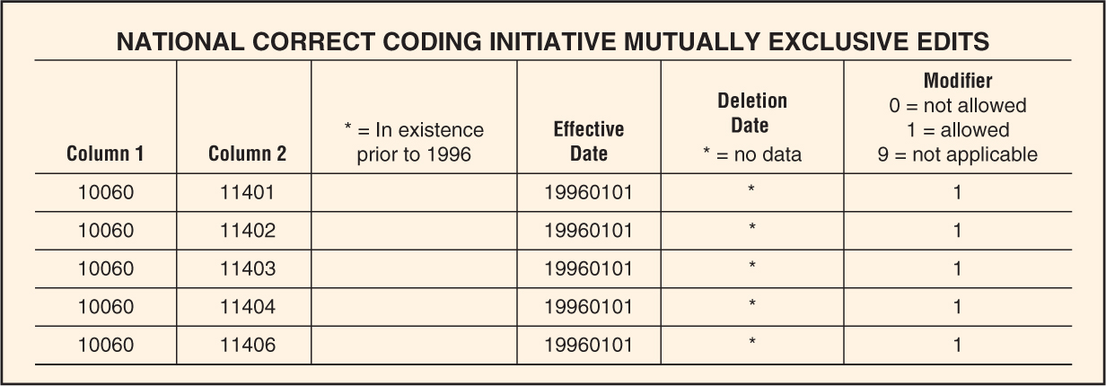
Sample NCCI Mutually Exclusive Edits

Slide 162
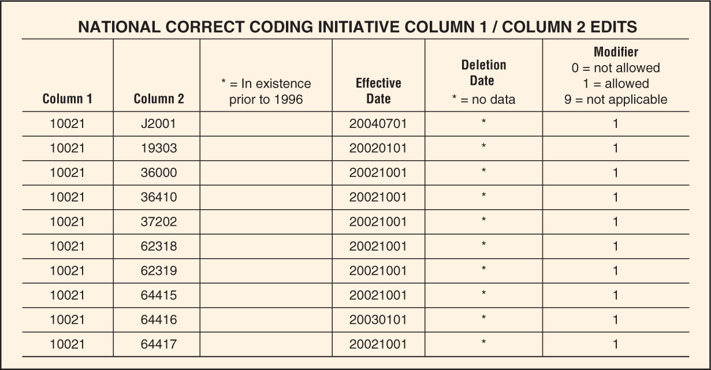
Sample NCCI Edits

Slide 163
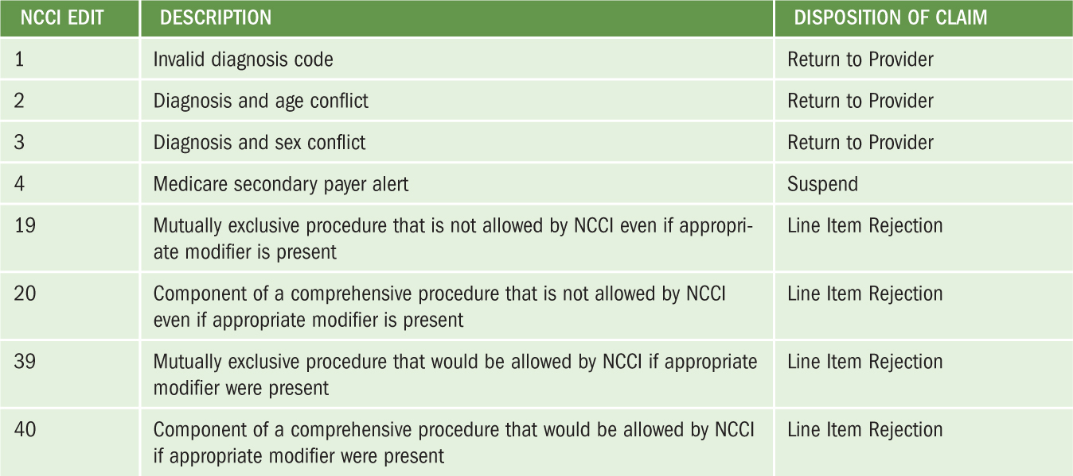
Partial Listing of NCCI Edits

Slide 164
Unbundling CPT Codes
Providers are responsible for reporting CPT and HCPCS level II codes that most comprehensively describe services provided.
NCCI edits are designed to detect unbundling, which is the reporting of multiple codes for a service when a single comprehensive code should be assigned.
(continues)

Slide 165
Unbundling CPT Codes (continued)
Unbundling occurs because:
Provider’s coding staff unintentionally report multiple codes because they misinterpreted coding guidelines.
Reporting multiple codes is done to maximize reimbursement.

Slide 166
Unbundling CPT Codes (continued)
Unbundling occurs when:
One service is divided into its component parts and a code for each component part is reported as if performed as separate services.
A code for the separate surgical approach (e.g., laparotomy) is reported in addition to a code for the surgical procedure; procedures performed to gain access to an area or organ system are not separately reported.

